Slide 1
Chapter 27 – Magnetic Field and Magnetic Forces
Magnetism
Magnetic Field
Magnetic Field Lines and Magnetic Flux
Motion of Charged Particles in a Magnetic Field
Applications of Motion of Charged Particles
Magnetic Force on a Current-Carrying Conductor
Force and Torque on a Current Loop

Slide 2
1) A moving charge or collection of moving charges (e.g. electric current) produces a magnetic field. (Chap. 28).
2) A second current or charge responds to the magnetic field and experiences a magnetic force. (Chap. 27).
1. Magnetism
Permanent magnets: exert forces on each other as well as on unmagnetized Fe pieces.
The needle of a compass is a piece of magnetized Fe.
If a bar-shaped permanent magnet is free to rotate, one end points north (north pole of magnet).
An object that contains Fe is not by itself magnetized, it can be attracted by either the north or south pole of permanent magnet.
A bar magnet sets up a magnetic field in the space around it and a second body responds to that field. A compass needle tends to align with the magnetic field at the needle’s position.

Slide 3
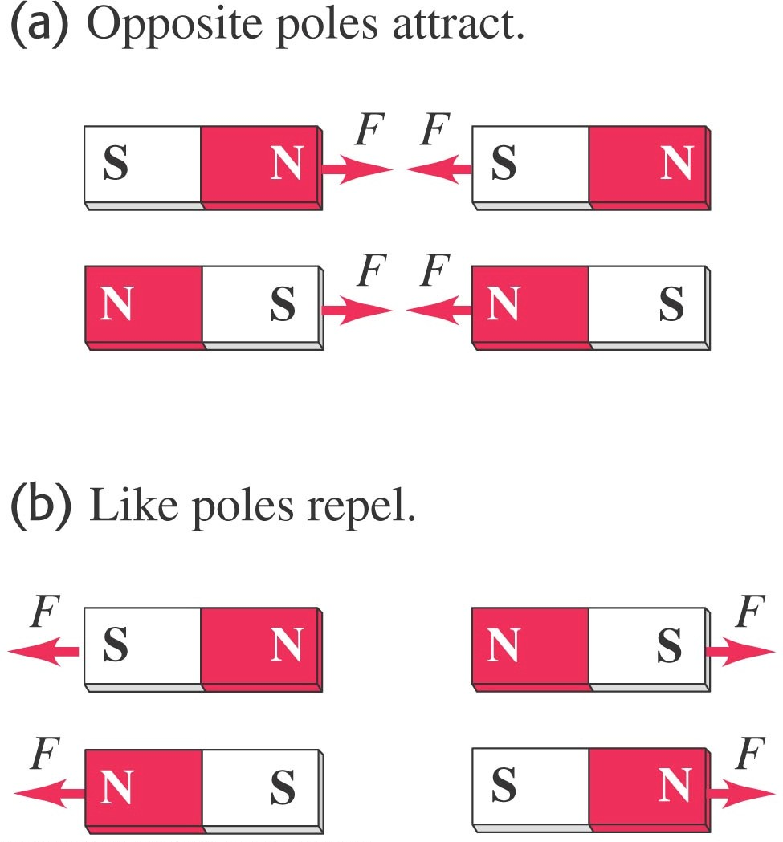
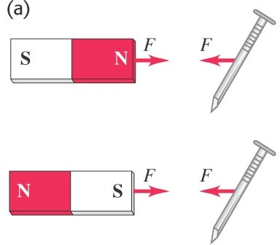
1. Magnetism
Magnets exert forces on each other just like charges. You can draw magnetic field lines just like you drew electric field lines.
Magnetic north and south pole’s behavior is not unlike electric charges. For magnets, like poles repel and opposite poles attract.
A permanent magnet will attract a metal like iron with either the north or south pole.

Slide 4
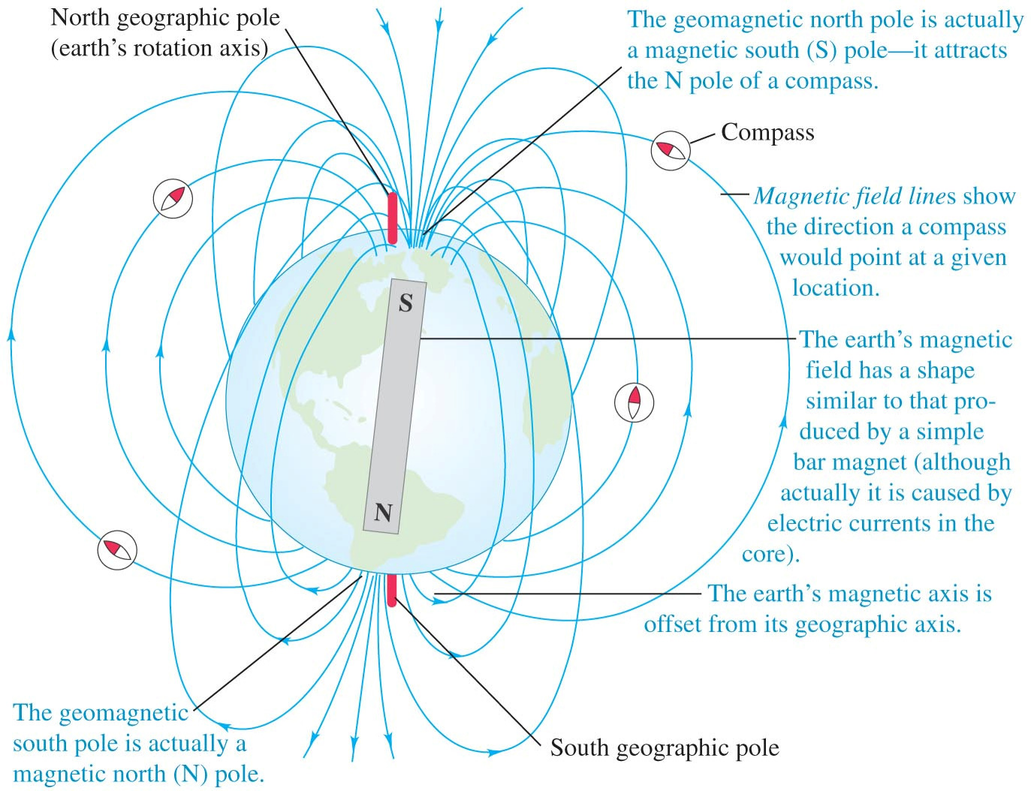
Magnetic poles about our planet

Slide 5
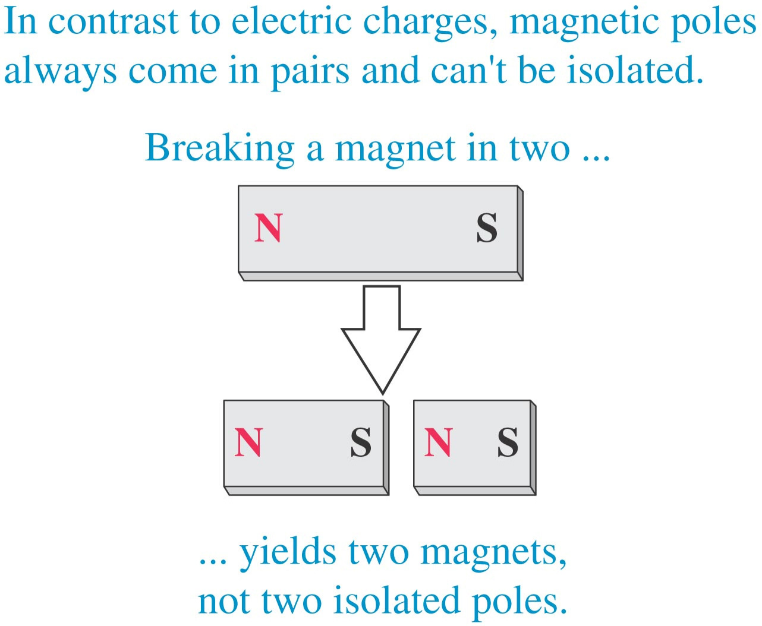
Magnetic declination / magnetic variation: the Earth’s magnetic axis is not parallel to its geographic axis (axis of rotation) € a compass reading deviates from geographic north.
Magnetic inclination: the magnetic field is not horizontal at most of earth’s surface, its angle up or down. The magnetic field is vertical at magnetic poles.
Magnetic Poles versus Electric Charge
- We observed monopoles in electricity. A (+) or (-) alone was stable, and field lines could be drawn around it.
- Magnets cannot monopoles. If you
exist as break a bar
magnet between N and S poles, you get two smaller magnets, each with its own N and S pole.

Slide 6
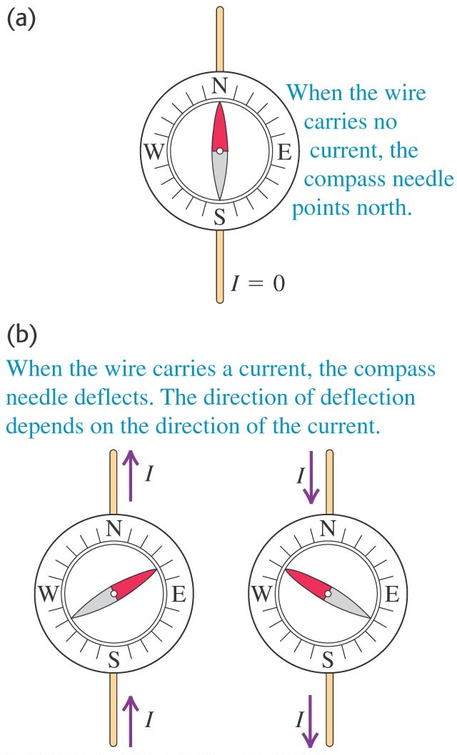
-In 1820, Oersted ran experiments with conducting wires run near a sensitive compass. The orientation of the wire and the direction of the flow both moved the compass needle.
- Ampere / Faraday / Henry €  moving a magnet near a conducting loop can induce a current.
- The magnetic forces between two bodies are due to the
interaction
between moving electrons in the atoms.
- Inside a magnetized body (permanent magnet) there is a coordinated motion of certain atomic electrons. Not true for unmagnetized objects.

Slide 7
2. Magnetic Field
Electric field:
A distribution of electric charge at rest creates an electric field E in the surrounding space.
The electric field exerts a force F_{E} = q E on any other charges in presence of that field.
Magnetic field:
A moving charge or current creates a magnetic field in the surrounding space (in addition to E).
The magnetic field exerts a force F_{m} on any other moving charge or current present in that field.
- The magnetic field is a vector field € vector quantity associated with each point in space.
F_{m} = q v⊥ B = q v B sin ϕ
- F_{m} is always perpendicular to B and v.
.
F_{m} = qv × B

Slide 8
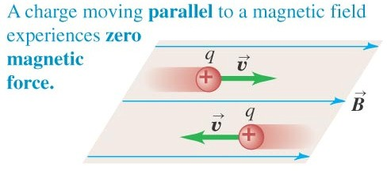
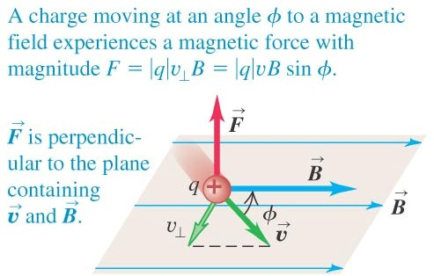
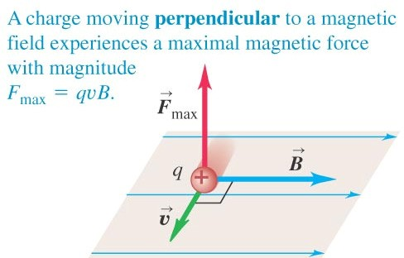
2. Magnetic Field
- The moving charge interacts with the fixed magnet. The force between them is at a maximum when the velocity of the charge is perpendicular to the magnetic field.
Interaction of magnetic force and charge

Slide 9
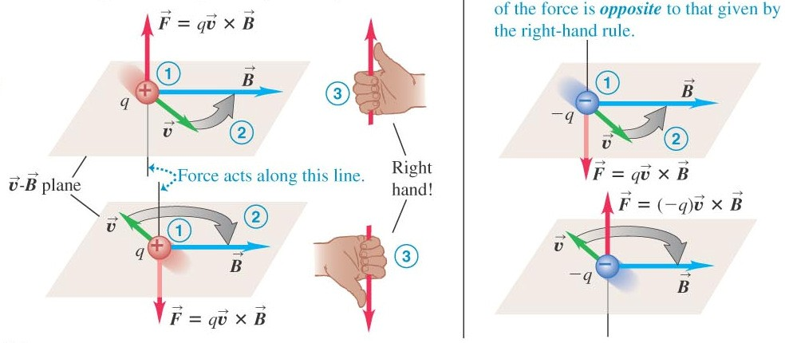
Right Hand Rule
Positive charge moving in magnetic field
€direction of force follows right hand rule
Negative charge € F direction contrary to right hand rule.
F = q vB⊥
Units: 1 Tesla = 1 N s / C m = 1 N/A m 1 Gauss = 10⁻⁴ T

Slide 10
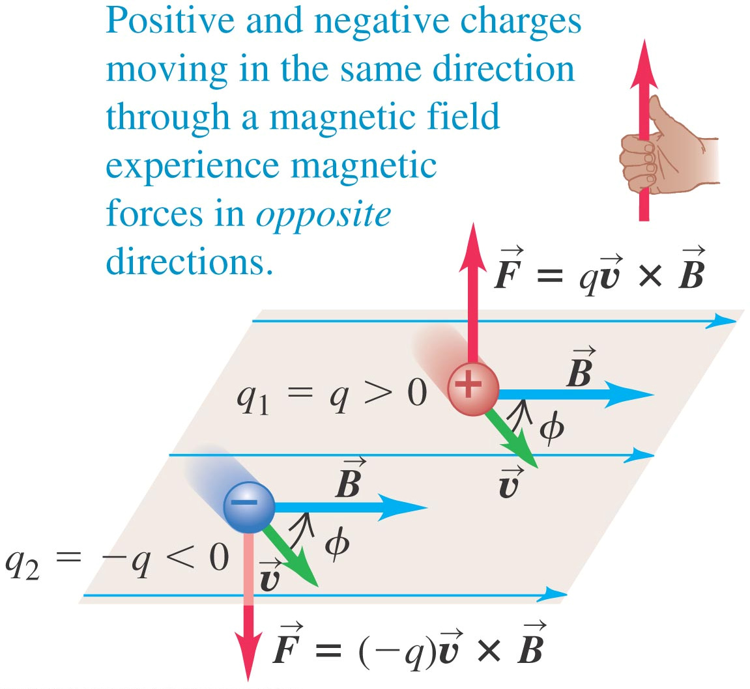
Right Hand Rule
If charged particle moves in region where both, E and B are present:
.
F = q(E + v × B)

Slide 11
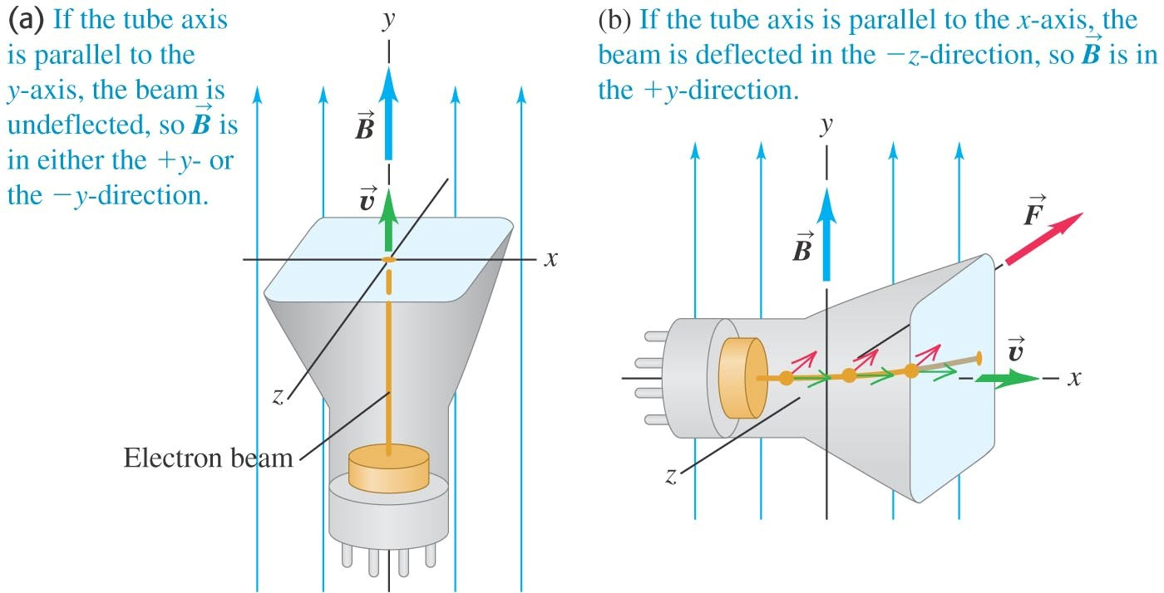
Measuring Magnetic Fields with Test Charges
Ex: electron beam in a cathode X-ray tube.
- In general, if a magnetic field (B) is present, the electron beam is deflected.
However this is not true if the beam is // to B (φ = 0, π € F=0 €  no deflection).
Electron q< 0 €  F has contrary direction to right hand rule
No deflection € F = 0 €  v // B
Deflection € F ≠ 0 € F ┴ v, B

Slide 12
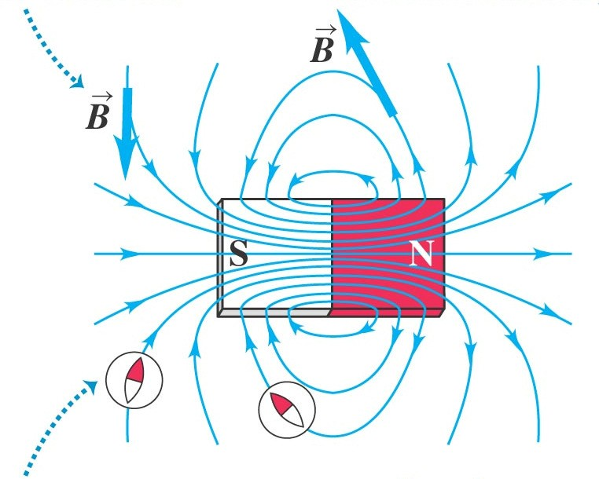
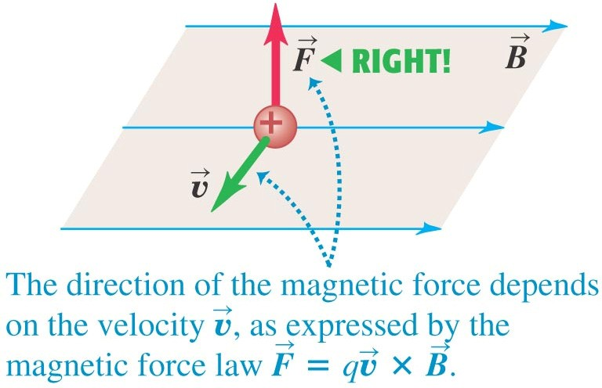
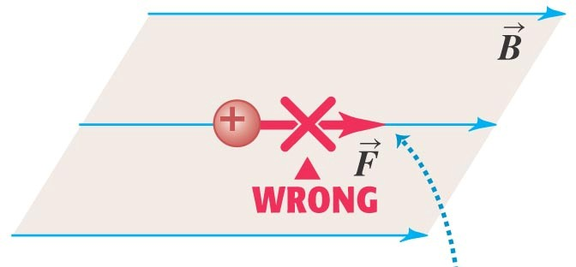
3. Magnetic Field Lines and Magnetic Flux
Magnetic field lines may be traced from N toward S (analogous to the electric field lines).
At each point they are tangent to magnetic field vector.
The more densely packed the field lines, the stronger the field at a point.
Field lines never intersect.
The field lines point in the same direction as a compass (from N toward S).
Magnetic field lines are not “lines of force”.

Slide 13
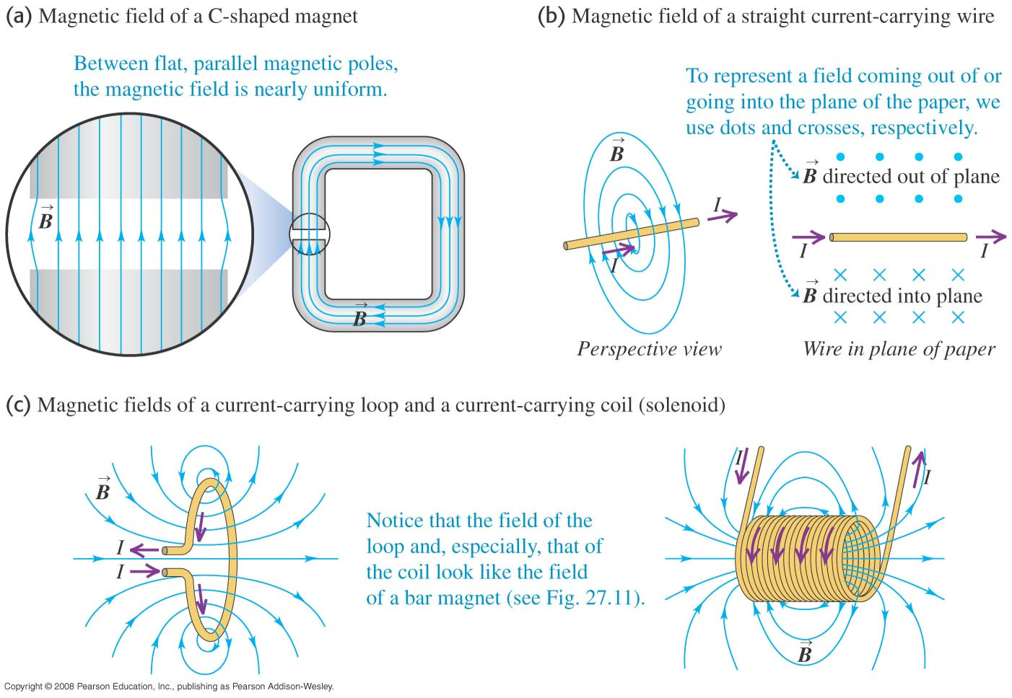
- Magnetic field lines have no ends € they continue through the interior of the magnet.

Slide 14
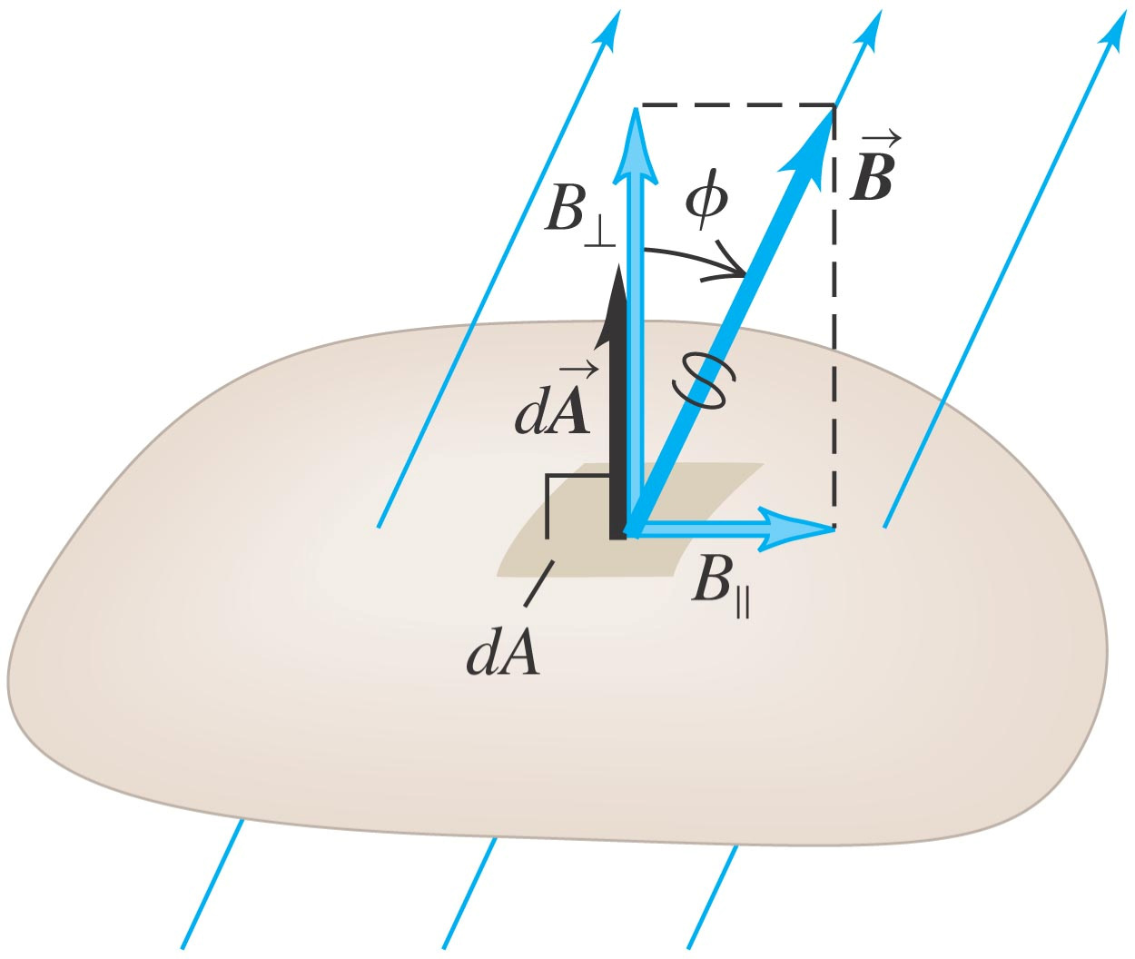
Φ _{B} = ∫ B⊥ dA = ∫ B cosϕ ⋅ dA = ∫ B ⋅ dA
Magnetic Flux and Gauss’s Law for Magnetism
- Magnetic flux is a scalar quantity.
- If B is uniform:
Φ _{B} = B⊥ A = BA cosϕ
Units: 1 Weber (1 Wb = 1 T m² = 1 N m / A)
- Difference with respect to electric flux € the total magnetic flux through a closed surface is always zero. This is because there is no isolated magnetic charge (“monopole”) that can be enclosed by the Gaussian surface.
_{B =} dΦ _{B}
dA⊥
Φ _{B} = ∫ B ⋅ dA = 0
- The magnetic field is equal to the flux per unit area across an area at right angles to the magnetic field = magnetic flux density.

Slide 15
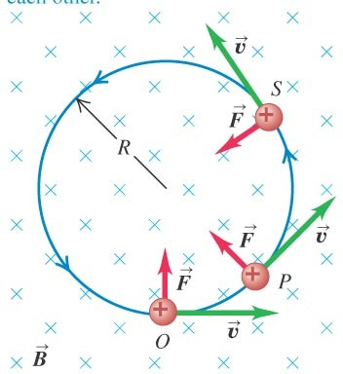
4. Motion of Charged Particles in a Magnetic Field
.
- Magnetic force perpendicular to v € it cannot change the magnitude of the velocity, only its direction.
F_{m} = qv × B
F does not have a component parallel to particle’s motion € cannot do work.
Motion of a charged particle under the action of a magnetic field alone is always motion with constant speed.
Magnitudes of F and v are constant (v perp. B) € uniform circular motion.
_{v}2
F = q ⋅ v ⋅ B = m
R
Radius of circular orbit in magnetic field:
_{R =} mv
q B
+ particle € counter-clockwise rotation.
- particle € clockwise rotation.

Slide 16
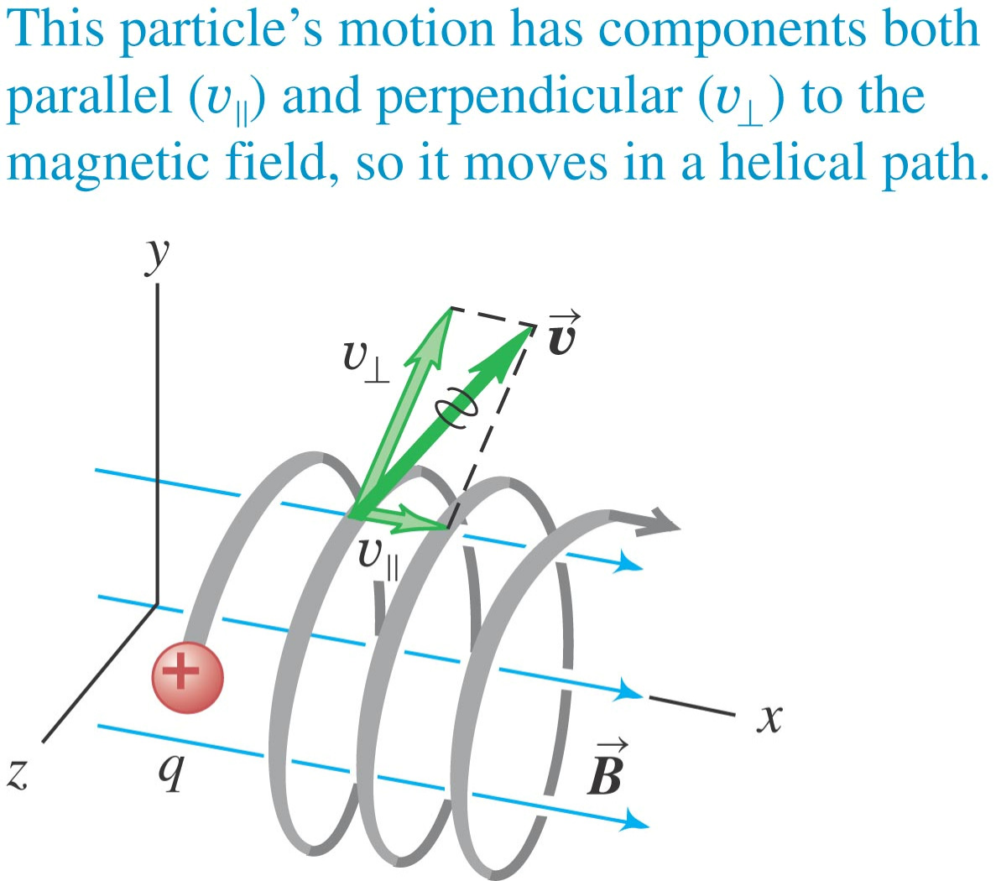
q B q B
ω = v =
mv m
Angular speed: ω = v/R €
Cyclotron frequency: f = ω/2π
- If v is not perpendicular to B € v// (parallel to B) constant because F// = 0 €
particle moves in a helix. (R same as before, with v = v┴).
A charged particle will move in a plane perpendicular to the magnetic field.

Slide 17
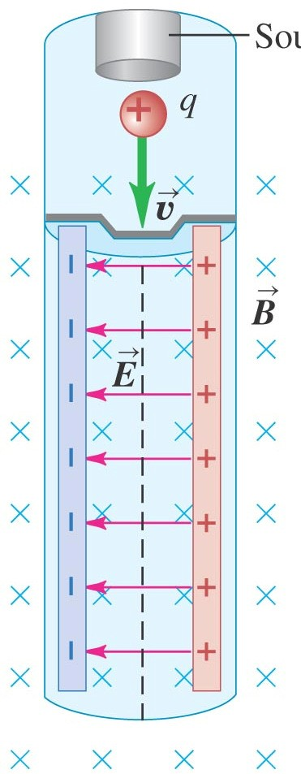
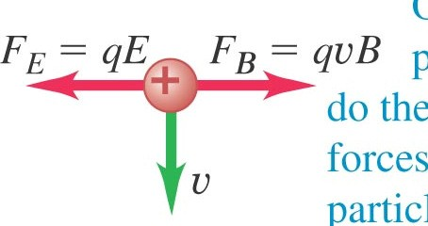
5. Applications of Motion of Charged Particles
Source of charged
Velocity selector
particles
Particles of a specific speed can be selected from the beam using an arrangement of E and B fields.
F_{m} (magnetic) for + charge towards right (q v B).
F_{E} (electric) for + charge to left (q E).
F_{net} = 0 if F_{m} = F_{E} € -qE + q v B = 0 € v = E/B
Only particles with speed E/B can pass through without being deflected by the fields.

Slide 18
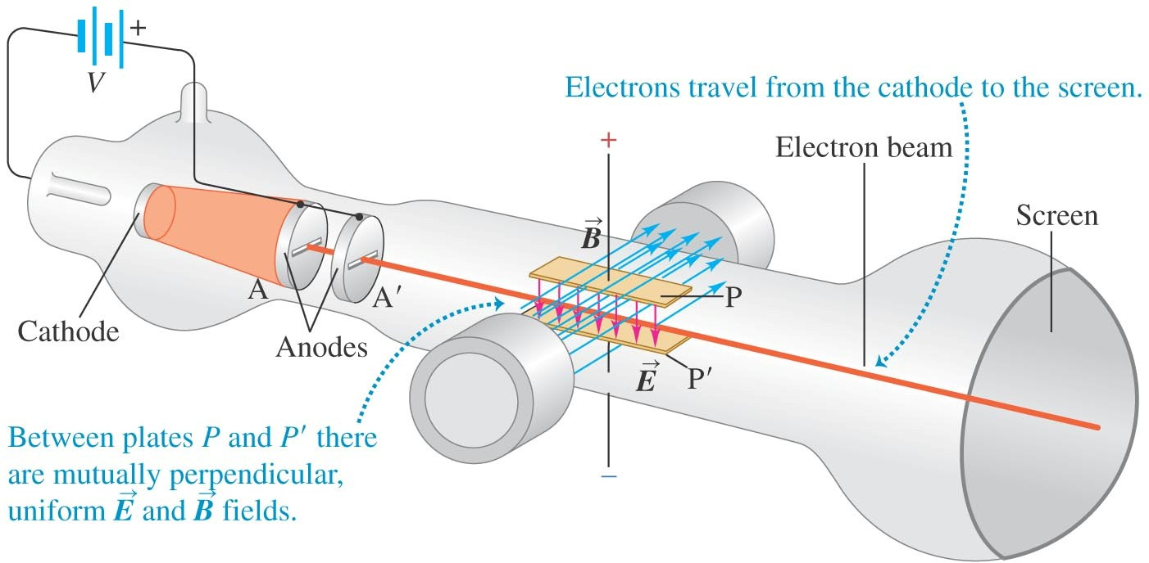
2eV m
Thomson’s e/m Experiment
∆E = ∆K + ∆U =0 € 0.5 m v = U = e V
v = ^{E} =
B
2
2
e ₌ E
m 2VB²
e/m does not depend on the cathode material or residual gas on tube € particles in the beam (electrons) are a common constituent of all matter.

Slide 19
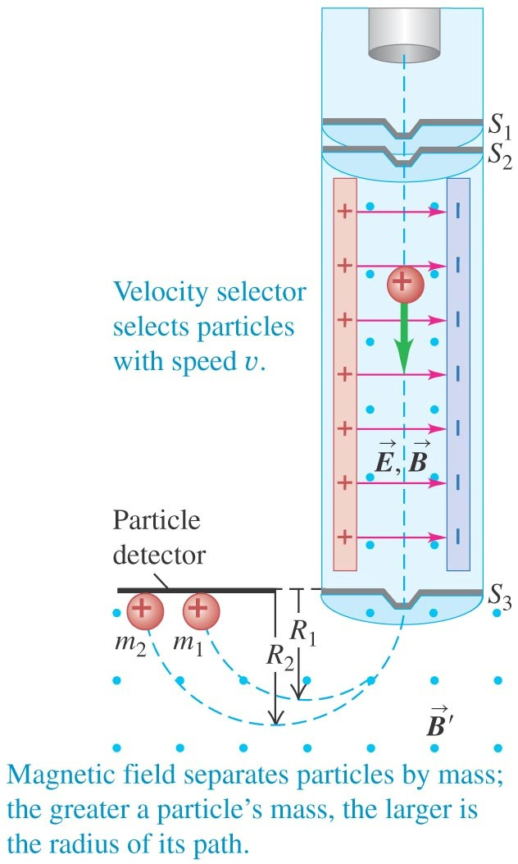
Mass Spectrometer
Using the same concept as Thompson, Bainbridge was able to construct a device that would only allow one mass in flight to reach the detector.
Velocity selector filters particles with v = E/B. After this, in the region of B’ particles with m₂ > m₁ travel with radius (R₂ > R₁).
_{R =} mv
q B'

Slide 20
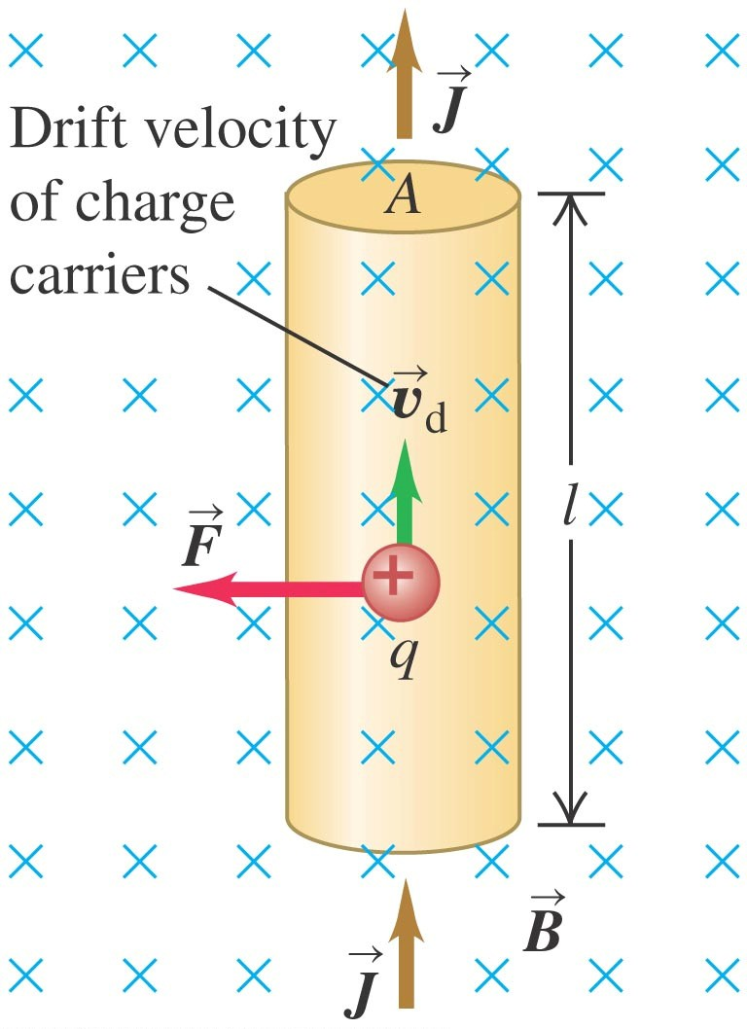
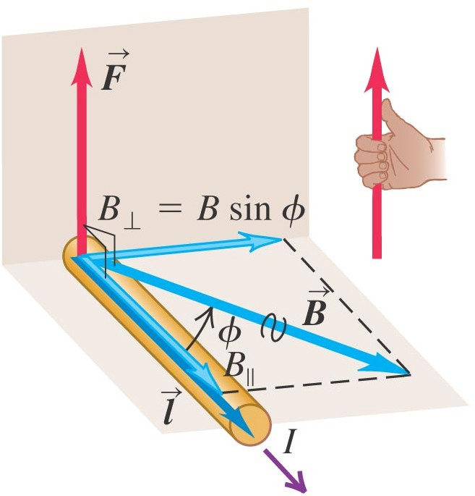
6. Magnetic Force on a Current-Carrying Conductor
.
F_{m} = qv_{d} B
F_{m} = (nAl)(qv_{d} B)
F_{m} = qv_{d} × B
- Total force:
Force on one charge
n = number of charges per unit volume A l = volume
F_{m} = (nqv_{d} )( A)(lB) = (JA)(lB) = IlB
(B ┴ wire)
In general:
F = IlB⊥ = IlB sin ϕ
Magnetic force on a straight wire segment:
F = Il × B
Magnetic force on an infinitesimal wire section:
dF = Idl × B

Slide 21
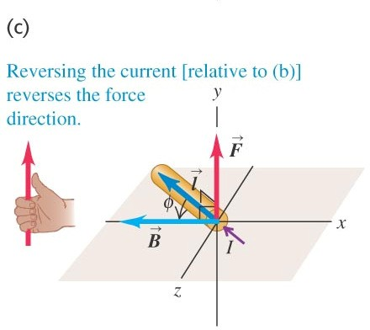
- Current is not a vector. The direction of the current flow is given by dl, not I. dl is tangent to the conductor.
F = Il × B

Slide 22
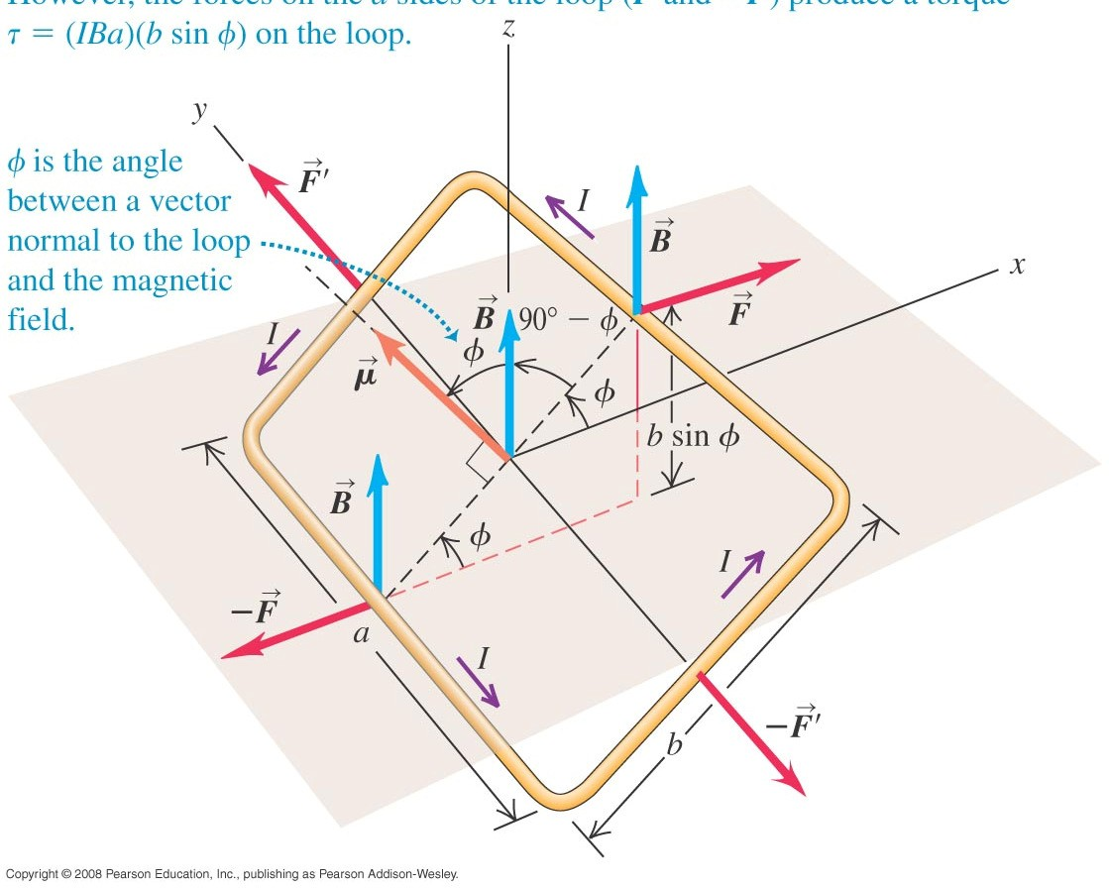
7. Force and Torque on a Current Loop
- The net force on a current loop in a uniform magnetic field is zero. Right wire of length “a” € F = I a B (B ┴ l)
Left wire of length “b” € F’ = I b B sin (90º - φ) (B forms 90º-φ angle with l)
F’ = I b B cos φ
F_{net} = F – F + F’ - F’ = 0
- Net torque ≠ 0 (general).
. .
τ = r × F
τ = r ⋅ F sin α =r ⊥ F = rF⊥
τ _{F '} = r ⋅ F sin 0 = 0
τ _{F} = F (b / 2) sin ϕ
○

Slide 23
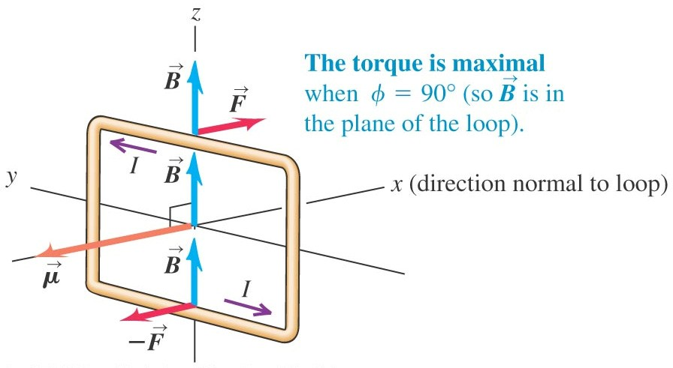
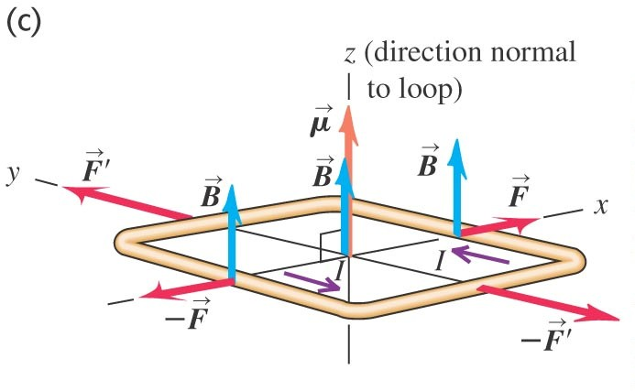
= τ _{F '} +τ _{F}
^{τ} total
+τ _{−F} = 0 + 0 + 2(b / 2)F sin ϕ
^{+τ} −F '
^{τ} total
= (IBa)(b sin ϕ) = IBAsin ϕ
Torque on a current loop
A = a b
Torque is zero, φ = 0º
φ is angle between a vector perpendicular to loop and B

Slide 24
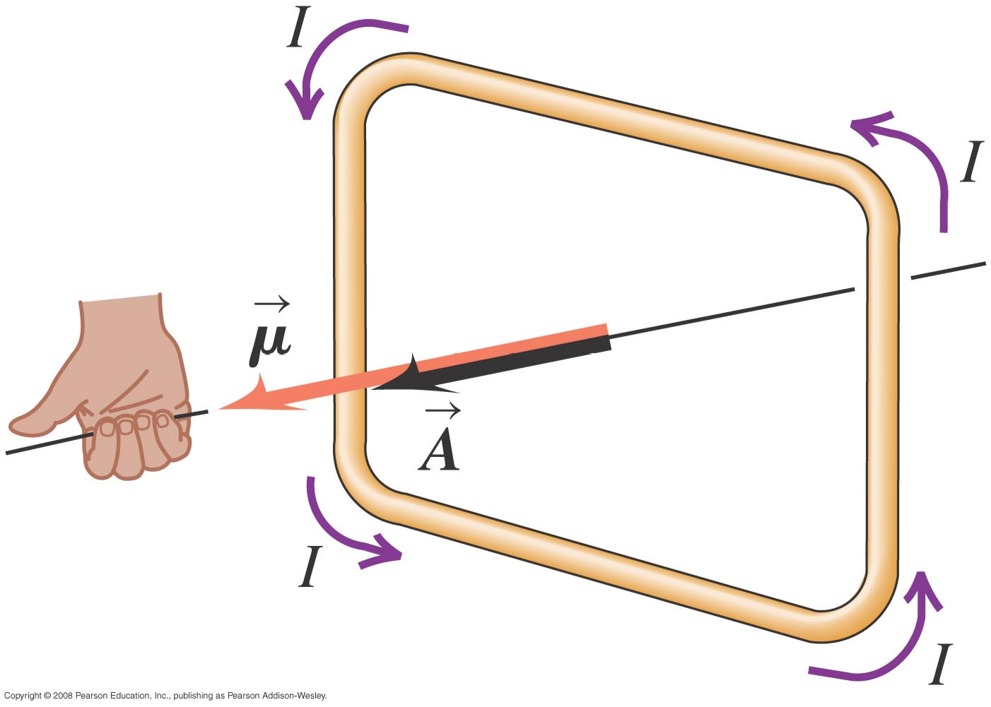
= IBAsin ϕ
^{τ} total
.
Magnetic dipole moment:
μ = IA
Electric dipole moment:
p = qd
Direction: perpendicular to plane of loop (direction of loop’s vector area € right hand rule)
^{τ} total
= μB sin ϕ
. .
. .
τ = μ × B
Electric torque:
τ = p × E
Magnetic torque:
Potential Energy for an Electric Dipole:
Potential Energy for a Magnetic Dipole:
.
U = −μ ⋅ B = −μB cosϕ
.
U = − p ⋅ E

Slide 25
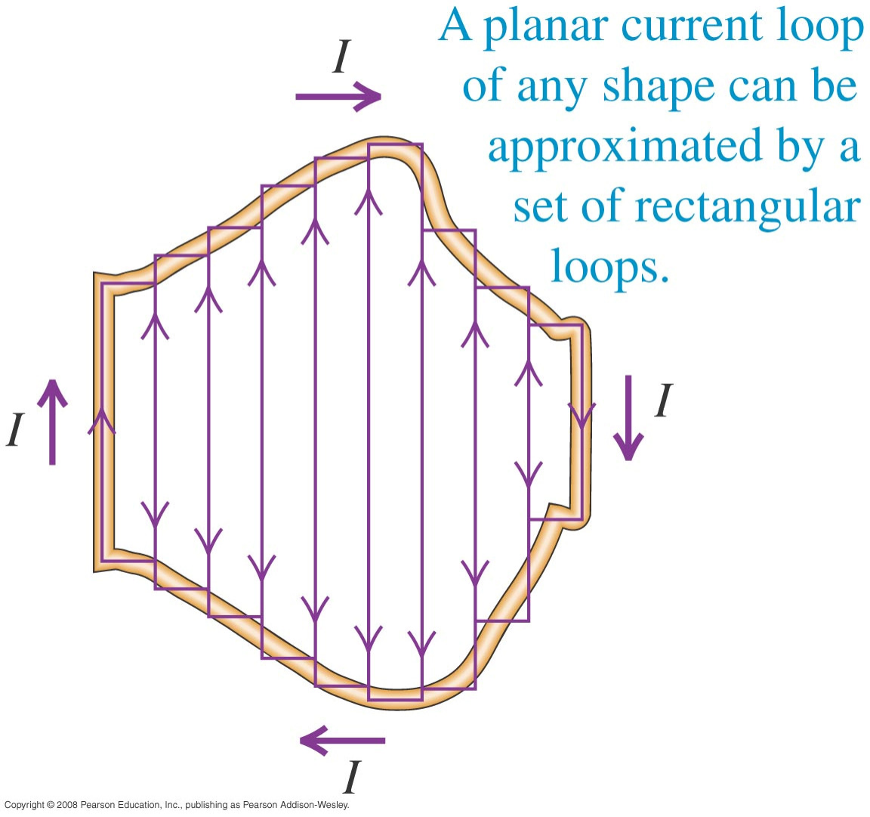
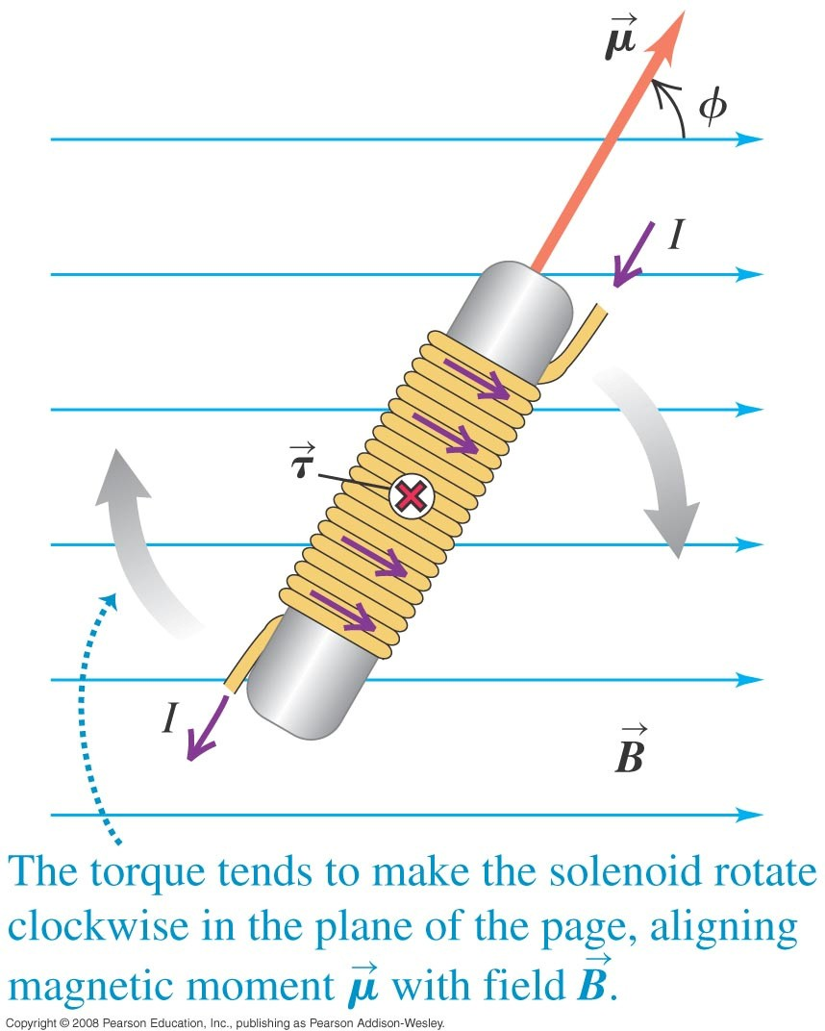
Magnetic Torque: Loops and Coils
If these loops all carry equal current “I” in same clockwise sense, F and torque on the sides
of two adjacent loops cancel, and only forces and torques around boundary ≠ 0.
Solenoid
τ = NIBAsin ϕ
N = number of turns
φ is angle between axis of solenoid and B
Max. torque: solenoid axis ┴ B.
Torque rotates solenoid to position where its axis is parallel to B.

Slide 26
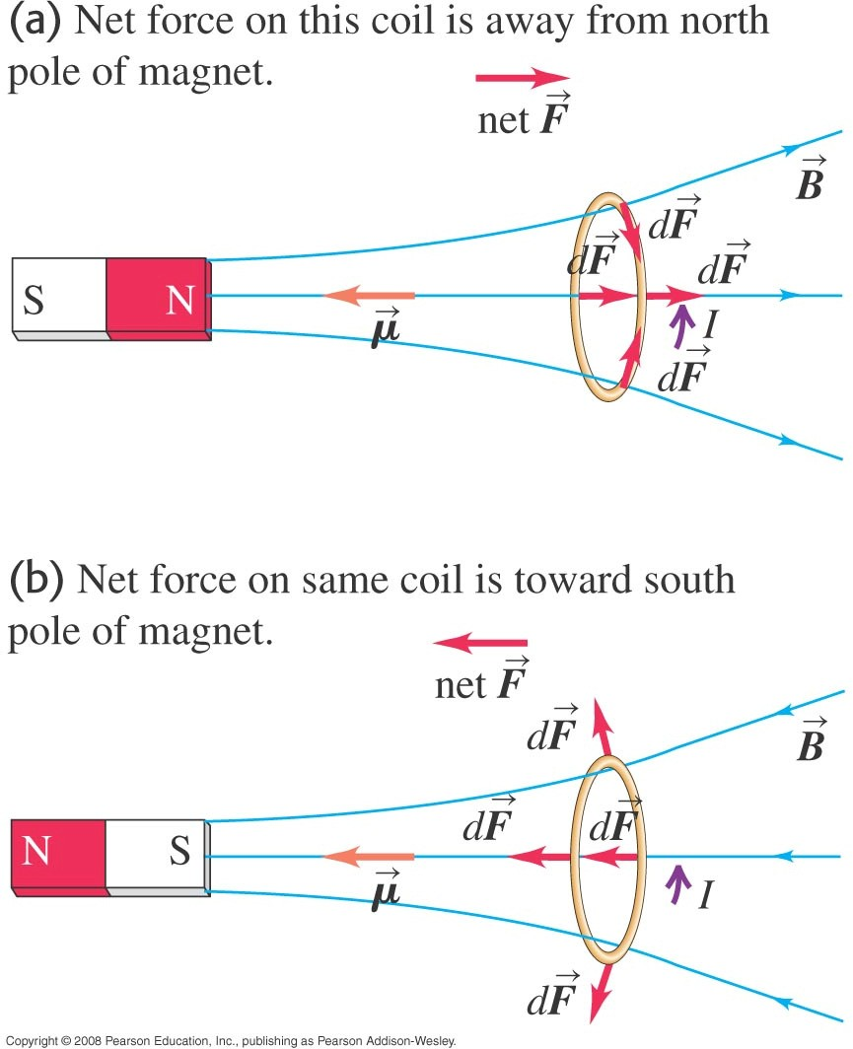
Magnetic Dipole in a Non-Uniform Magnetic Field
- Net force on a current loop in a non-uniform field is not zero.
dF = Idl × B
Radial force components cancel each Other € F_{net} to right.
N
S
If polarity of magnet changes €
F_{net} to left.
N
S

Slide 27
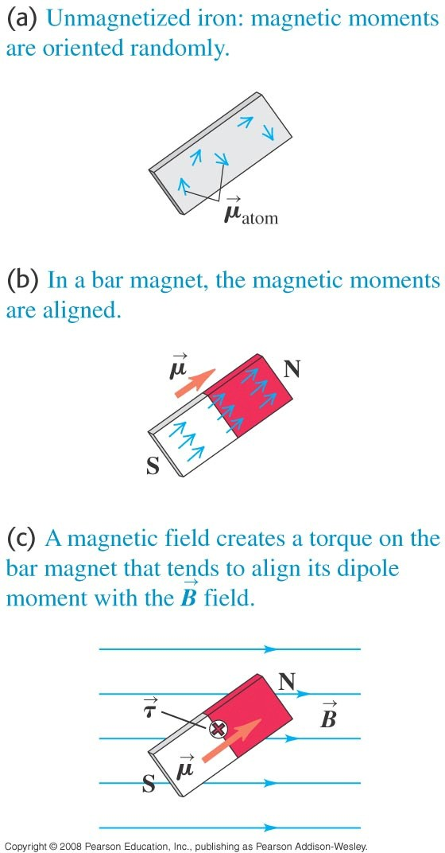
Magnetic Dipole and How Magnets Work
A solenoid and a magnet orients themselves with axis parallel to field.
Electron analogy: “spinning ball of charge”
€circulation of charge around spin axis similar to current loop € electron has net magnetic moment.
In Fe atom, large number of electron magnetic moments align to each other € non-zero atomic magnetic moment.
In unmagnetized Fe piece € no overall alignment of µ of atoms € total µ = 0.
Iron bar magnet € magnetic moments of many atoms are parallel € total µ ≠ 0.
A bar magnet tends to align to B, so that line from S to N is in direction of B.

Slide 28
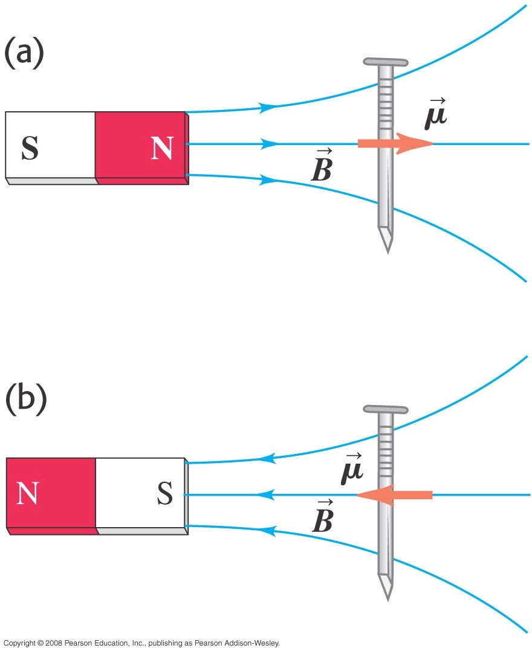
- South and North poles represent tail and head of magnet’s dipole moment, µ.
How can a magnet attract an unmagnetized Fe object?
Atomic magnetic moments of Fe try to align to B of bar magnet €  Fe acquires net magnetic dipole moment // B.
Non-Uniform B attracts magnetic dipole.
The magnetic dipole produced on nail is equivalent to current loop (I direction right hand rule) € net magnetic force on nail is attractive (a) or (b) € unmagnetized Fe object is attracted to either pole of magnet.
S
N
N
S

